Slide 1

BRITISH COLUMBIA INSTITUTE OF TECHNOLOGY
IWantToCry
RANSOMWARE’S EFFECT ON INDUSTRIAL ORGANIZATIONS
Notes:
Our group name IWantToCry, gains inspiration from the WannaCry ransomware which we use in our project. Our groups objective throughout the project was to detail the effects of ransomware on an industrial organization

Slide 2
01 | Introduction
02 | Original Network Design (V1)
03 | Vulnerability Scanning and Analysis
04 | Penetration Testing
05 | Improved Network Design (V2)
06 | Security Implementations
07 | Conclusion
08 | Questions
WHAT'S IN STORE
AGENDA

Slide 3



Meet the team
INTRODUCTION
Gian Gravela
Network Design
Penetration Testing
Security Implementations
Vulnerability Analysis
Configuration
Scott Zheng
Installation & Configuration
Security Implementation
Penetration Testing
Kevin Chou
Vulnerability Analysis and Scanning
Scheduling
Notes:
GIAN

Slide 4
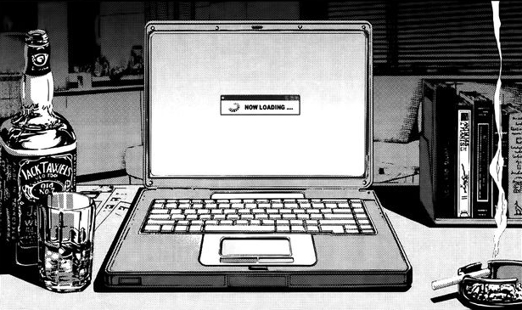
Scope
INTRODUCTION
Creation of Network
Virtual Test Network with Vulnerabilities (V1)
Vulnerability Testing and Scanning
a. Penetration Testing
b. Vulnerability Scanning
c. Vulnerability Assessment
Security Implementation
a. ISA/IEC 62443
b. Device Hardening
c. Endpoint Protection
d. Firewalls
e. IDMZ
Notes:
GIAN

Slide 5

Cyberattack
INTRODUCTION
Simulate ransomware attack using WannaCry
Ransomware worm
Used vulnerability in SMBv1 (MS17-010)
Encrypts files on the PC’s hard drive
One of the biggest ransomware attacks
Estimated 300,000 computers in 150 nations
Disruption of services
Notes:
Disruption of services: The WannaCry ransomware spread rapidly across the National Health Services network, infecting thousands of computers and disrupting critical services. Hospitals and clinics experienced difficulties accessing patient records, appointment systems, and test results, causing delays and disruptions in patient care.
Can you guys imagine if this happened to the hospitals and clinics in canada? Well a lot of people's lives would be at risk.
I will now pass it off to scott who will go over the original network design where we simulate the ransomware attack

Slide 6
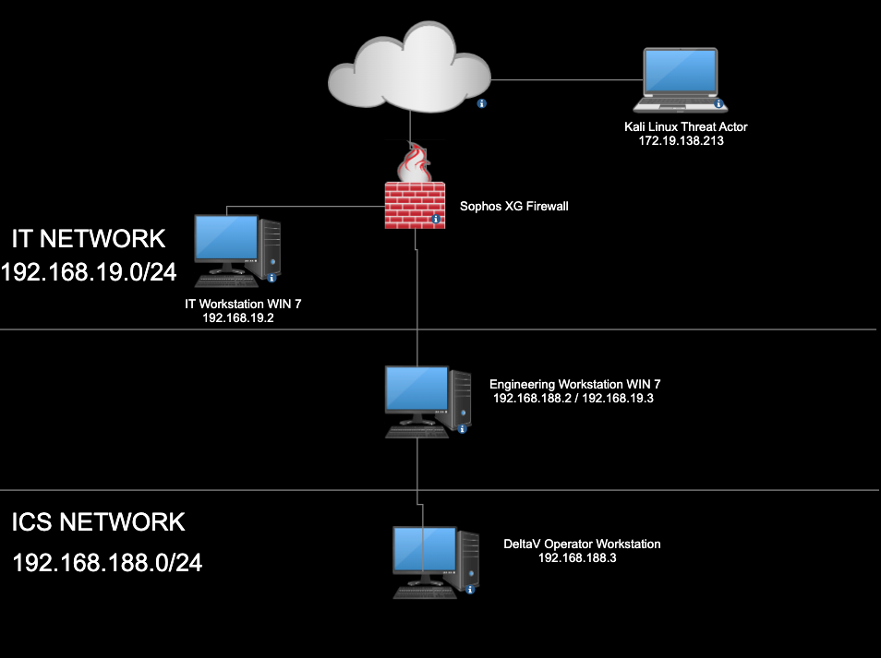
Network Diagram
Original Network Design (V1)
Built with VMWare
Built with vulnerabilities
Difficulty creating due to unfamiliarity with virtual networks
Difficulty creating due to unfamiliarity with firewalls
Notes:
Explain the whole network
Explain the firewall rules, how IT network and ICS network can communicate with each other, no security on the firewall at all.
Why we chose DeltaV, why we chose the Sophos XG firewalls

Slide 7
Networking
Original Network Design (V1)
LAN
Two host only networks (IT Network, ICS Network)
Static IPv4 addressing
WAN
Bridged network with local machine
Routing
Firewall acted as router
Internet connection for both LANs
No security on the firewall
Notes:
MASQ NAT rule was used

Slide 8
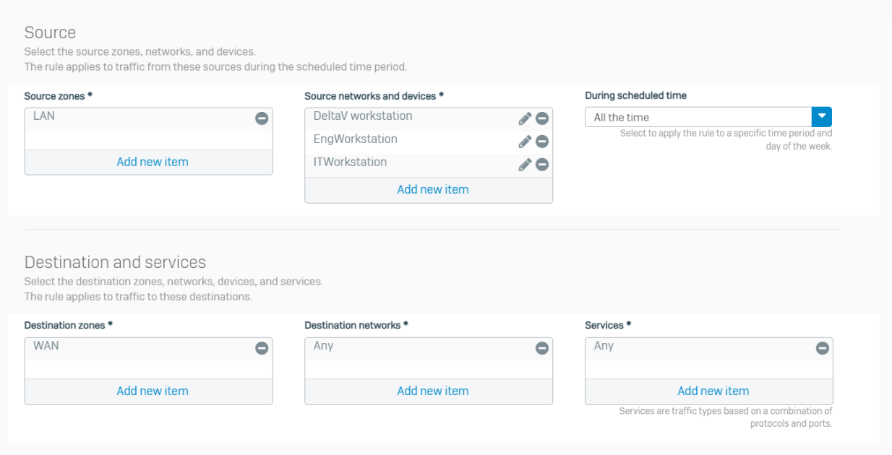
Networking
Original Network Design (V1)
Notes:
This is the rule defined for the the LAN to access the internet…. then explain everything
after finishing branch it to vulnerability scanning and analysis… “I will now pass it off to kevin who conducted vulnerability scanning and analysis on our network”

Slide 9

Vulnerability Scanning and Analysis
Notes:
KEVIN

Slide 10
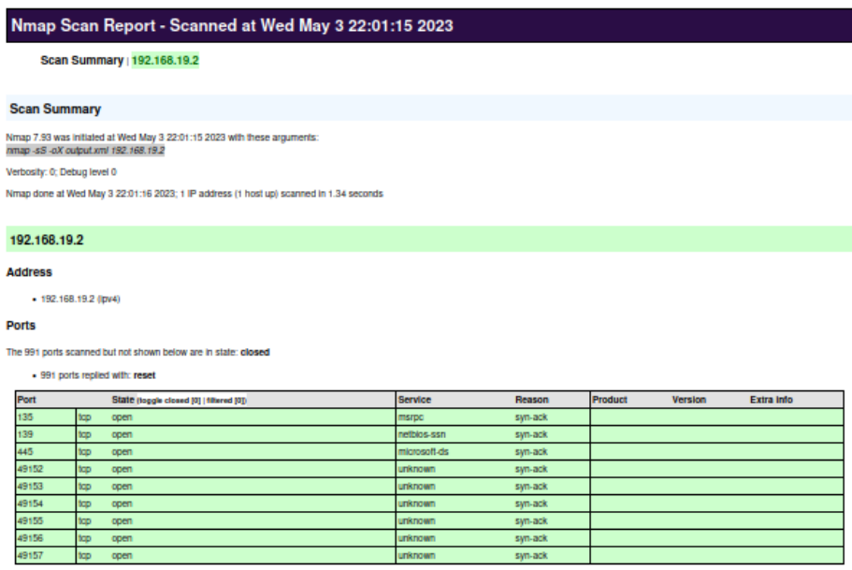
Vulnerability Scanning
Nmap
Scan
Open-source network scanning tool
Valuable information for identifying potential vulnerabilities

Slide 11
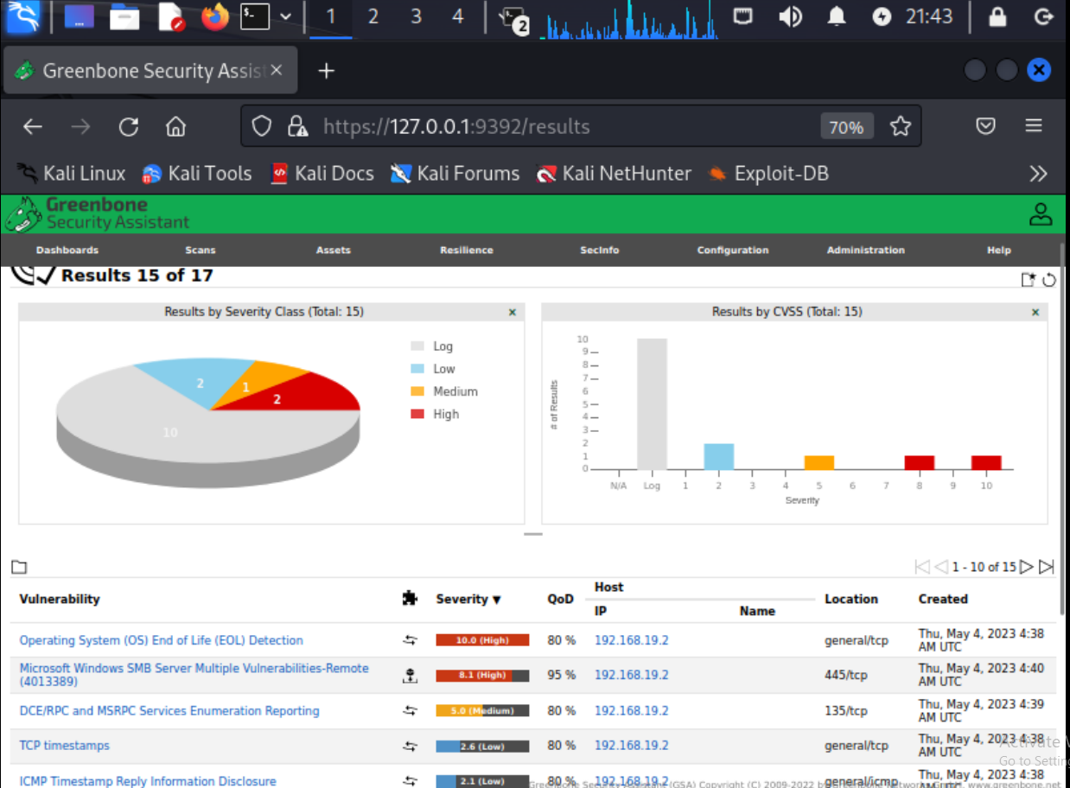
Vulnerability Scanning
Greenbone
Security
Assistant
Web-based user interface
Allows management and configuration of vulnerability scans, scan results, and reports

Slide 12
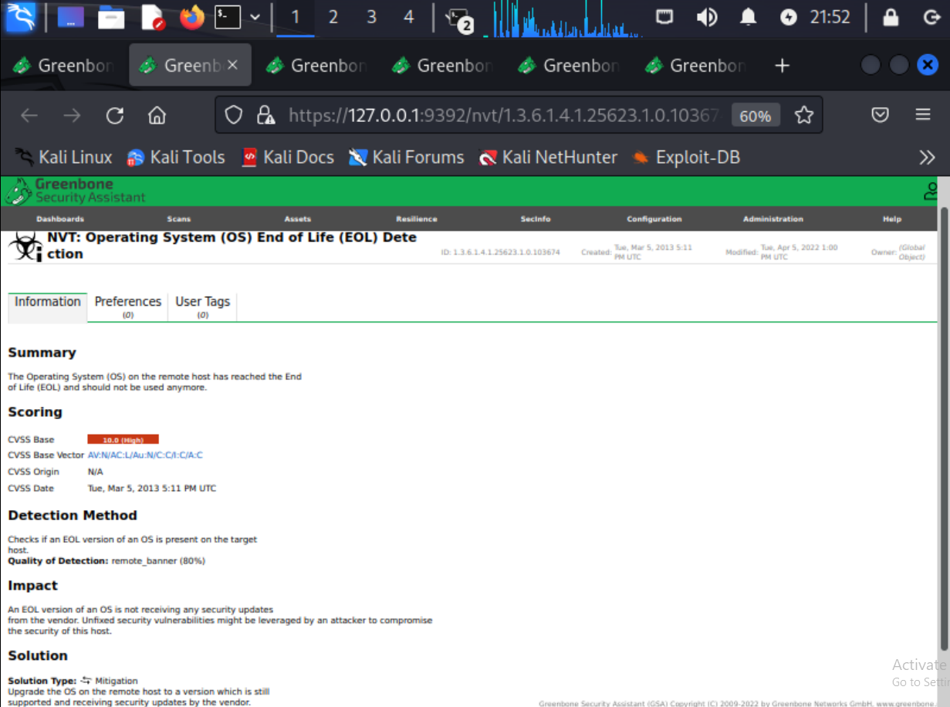
Vulnerability Scanning
Greenbone
Security
Assistant
Summary
Impact
Solution

Slide 13
Vulnerability Analysis
Network Segmentation
Workstations are interconnected
No distinct separation
Exposes network to vulnerabilities and increases risk levels
Solution: Segment networks and add IDMZ zone
Notes:
scott will discuss about later

Slide 14

Vulnerability Analysis
Human User
Identification/Authentication
Workstations and firewalls do not employ any authentication
Malicious users can access the network
Solution: Implement user accounts and passwords

Slide 15

Vulnerability Analysis
Using ISA/IEC 62443
Discover vulnerabilities
Level of potential exposure
Level of impact on end user
Root cause analysis
Complexity of the change

Slide 16
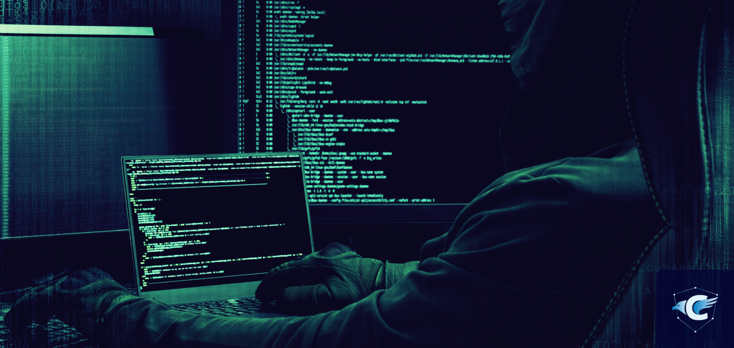
Summary
Penetration Testing
Gain access to host on network
Escalate privileges if needed
Install WannaCry

Slide 17
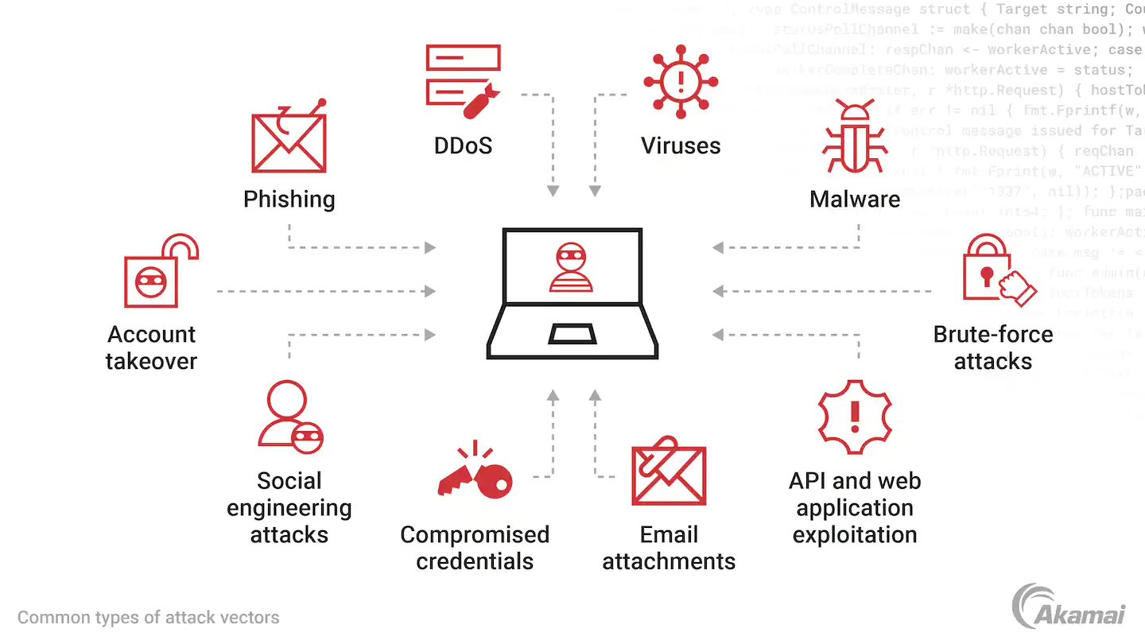
Attack Vector
Penetration Testing
Vulnerability Exploits
MS17-010
EternalBlue
Trojan
Reverse TCP shell
Privilege Escalation
Notes:
In the following slides we will be highlighting our preferred method: vulnerability exploits.

Slide 18
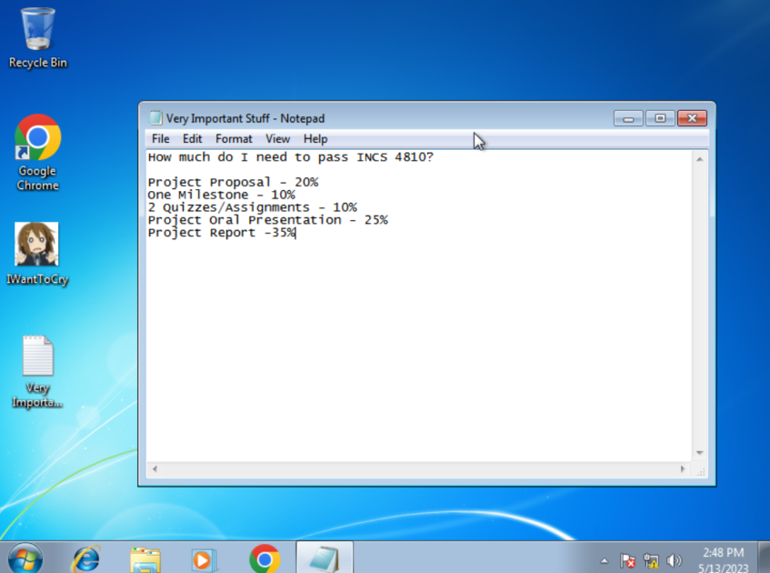
Vulnerability Exploits - Before installation of WannaCry
Penetration Testing

Slide 19
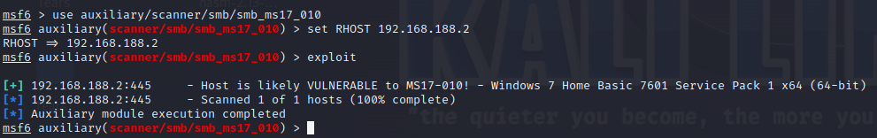
Vulnerability Exploits - Scanning
Penetration Testing

Slide 20
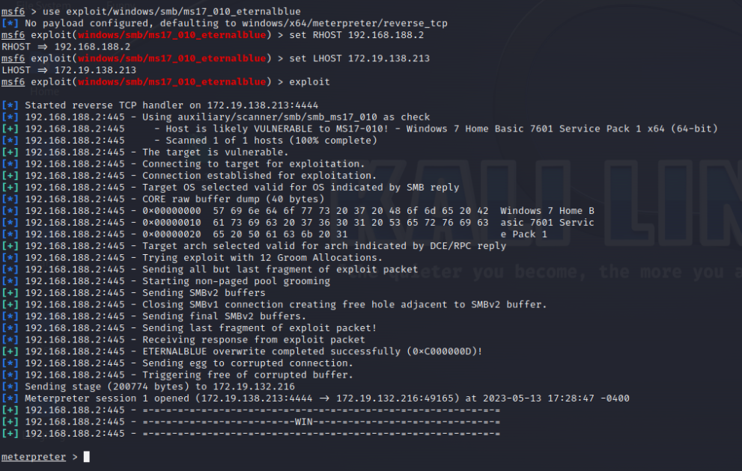
Vulnerability Exploits - Exploitation
Penetration Testing
Command to exploit device

Slide 21
Vulnerability Exploits - Exploitation
Penetration Testing
Output of command to exploit

Slide 22
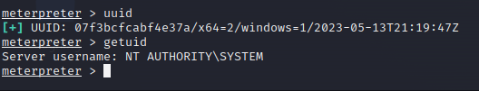
Vulnerability Exploits - Escalating Privileges
Penetration Testing

Slide 23
Vulnerability Exploits - Installation of WannaCry
Penetration Testing

Slide 24
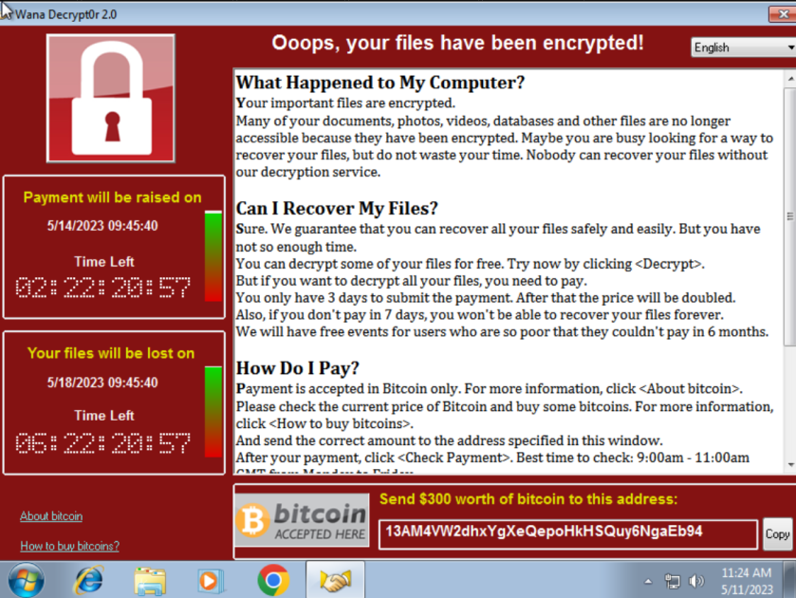
Vulnerability Exploits - End Result
Penetration Testing

Slide 25
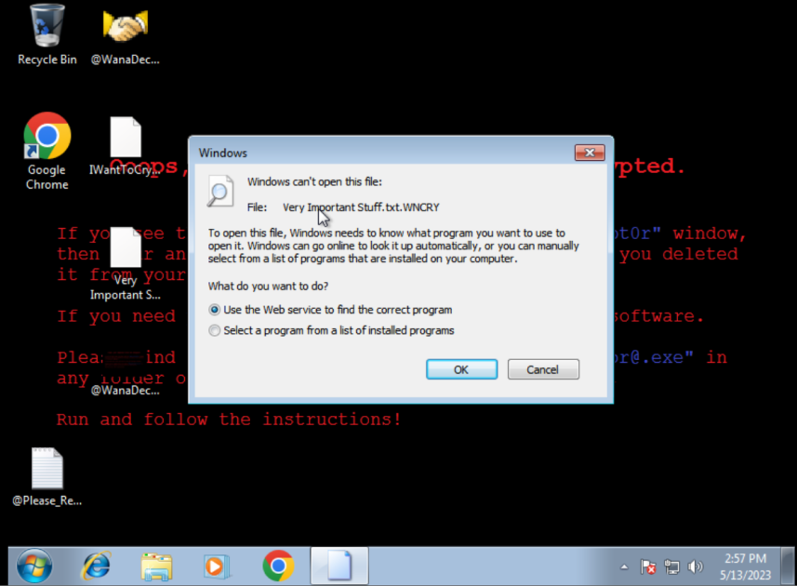
Vulnerability Exploits - End Result
Penetration Testing

Slide 26
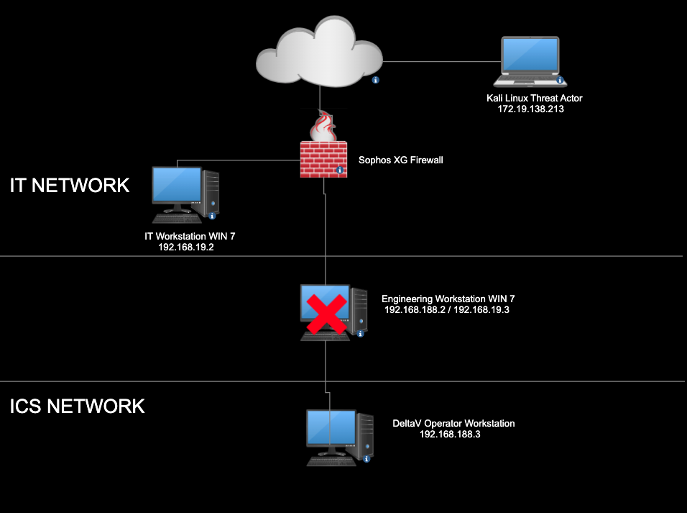
Network Propagation
Penetration Testing
Notes:
As I’ve explained, the WannaCry ransomware is also a worm which means it has the ability to propagate over a network. This makes the engineering workstation the perfect place to install the ransomware, since it is connected to the IT network and ICS Network. Now in due time, the ransomware will propagate and the topology will now look like this.

Slide 27
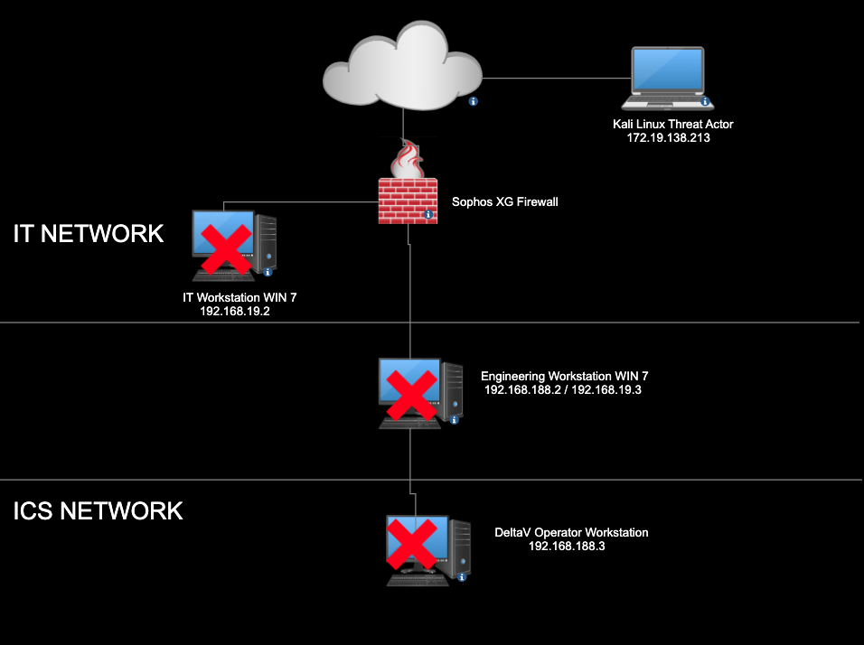
Network Propagation
Penetration Testing
Notes:
The IT workstation and DeltaV workstation if vulnerable to eternalblue, will be infected with WannaCry without having to interact directly with the ransomware.

Slide 28

After thoughts
Penetration Testing
How can a ransomware attack affect industrial organizations?
Operational disruptions
Financial losses
Safety risk
Notes:
An industrial organization, the colonial pipeline suffered a ransomware attack in May 2021, which caused the company to shut down its operations due to the ransomware attack. It’s estimated that they payed 4.4 million to regain control of their systems
And of course a ransomware attack can cause safety risk
What if the ransomware attack reaches critical infrastructure such as power grids and water treatment facilities? Well this can potentially put lives at risk with the inability to monitor or control industrial processes with systems encrypted.
But of course, to combat a ransomware attack, we defined a improved network design with security implementations. I will now pass it off to scott who will explain V2

Slide 29
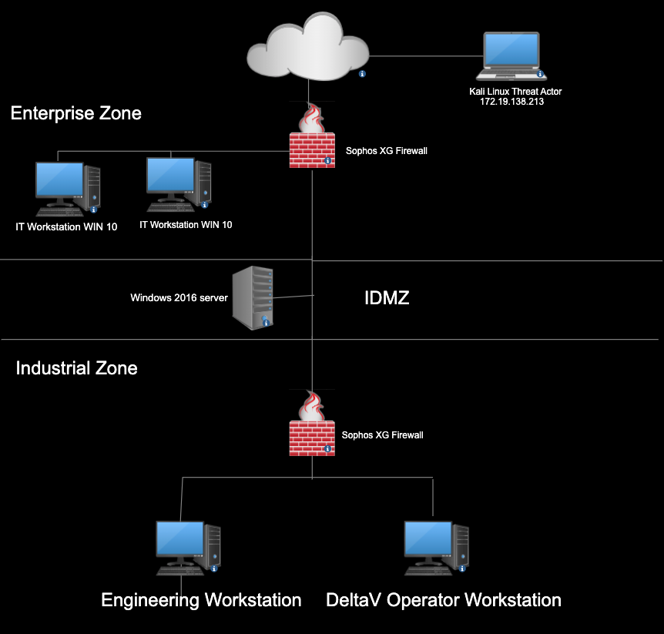
Network Diagram
Improved Network Design (V2)
Zones
Three zones were created
Strict communication rules and policies between zones
IDMZ
Prevents direct communication between both zones
Intent is to contain compromises so that production can continue
Notes:
Talk about how the propagation can stop due to IDMZ and proper network segmentation
“With proper network segmentation, this can limit the propagation of a ransomware worm such as wannacry”

Slide 30
Zones
Improved Network Design (V2)
Enterprise Zone
Can access the internet
Can access IDMZ
Cannot access the industrial zone
IDMZ Zone
Cannot access either zone
Industrial Zone
Cannot access the internet
Cannot access enterprise zone
Can access IDMZ

Slide 31
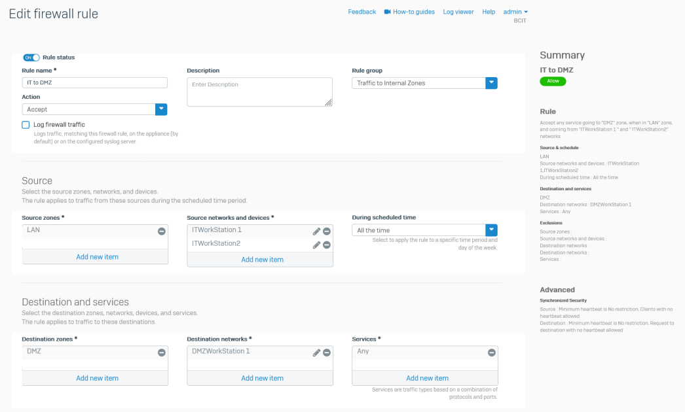
Zones
Improved Network Design (V2)
Notes:
FIREWALL RULES FOR COMMUNICATION BETWEEN ZONES
Pass it off to Gian

Slide 32

Summary
Security Implementations
Device Hardening
Sophos XG firewalls
Sophos Central
Use of ISA/IEC 62443 in V2
Notes:
GIAN

Slide 33

Security Implementations
Device Hardening
Disabled SMBv1
Updated workstation to WIN 10
Installed Sophos endpoint protection on workstations
Create user accounts

Slide 34
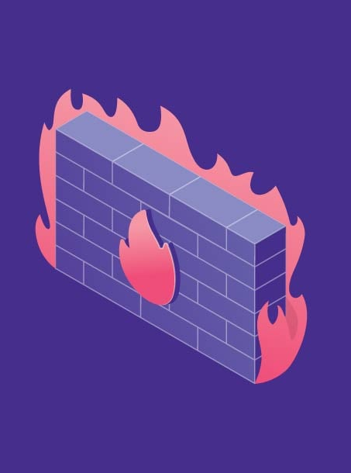
Security Implementations
Sophos XG Firewall
Network segmentation through IDMZ
Strict policies and rules on firewall
Zero-Day and ML Protection
Deep Packet Inspection
Cloud Sandbox
Notes:
Zero-day and ML protection will help instantly identify the latest ransomware and unknown threats before they get on our network
Our firewall also has the capability of deep packet inspection. Unlike stateful packet inspection, we have the ability to look at a more comprehensive range other than just the packet header. Deep packet inspection is able to catch threats or block detected attacks that may be hidden in the contents of the data.

Slide 35

Security Implementations
Sophos Central
Real-time information such as alerts
Threat Analysis Center - detection and remediation
User management - group users and apply policies
Cloud based platform

Slide 36
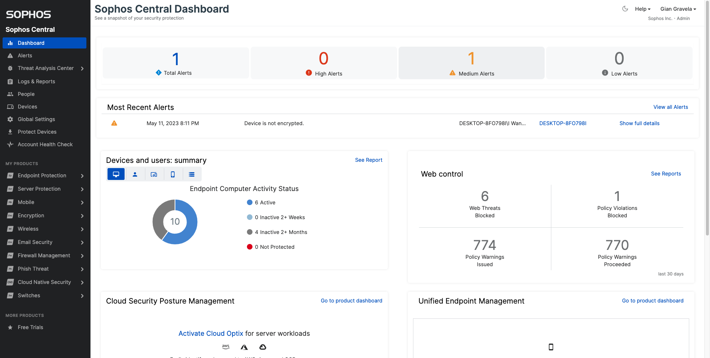
Sophos Central
Security Implementations

Slide 37
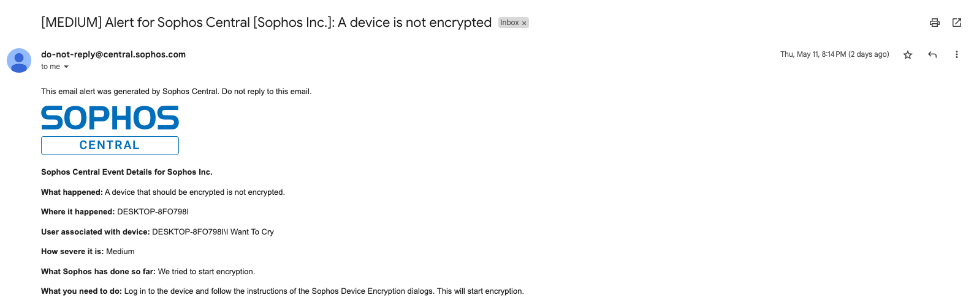
Sophos Central
Security Implementations

Slide 38
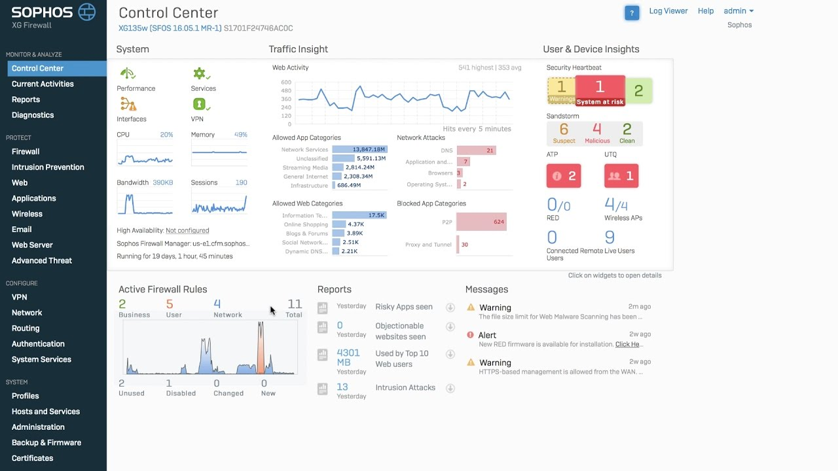
Sophos XG Firewalls
Security Implementations
Notes:
Our firewall has the capability of isolating an endpoint if its infected with malware

Slide 39
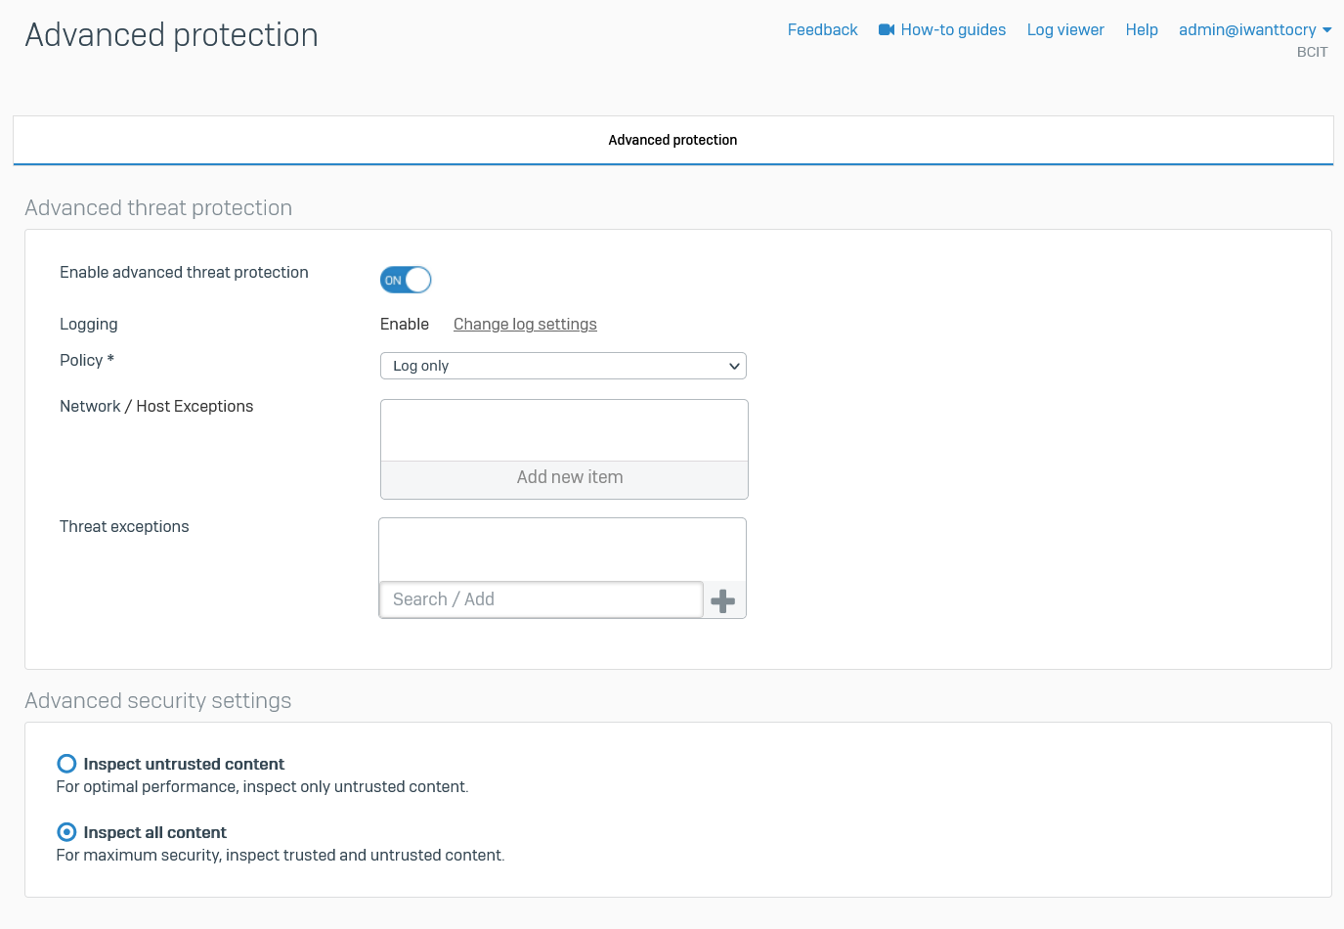
Sophos XG Firewalls
Security Implementations
Notes:
I will now pass it to scott who will explain the use of ISA/IEC 62443 in our network

Slide 40
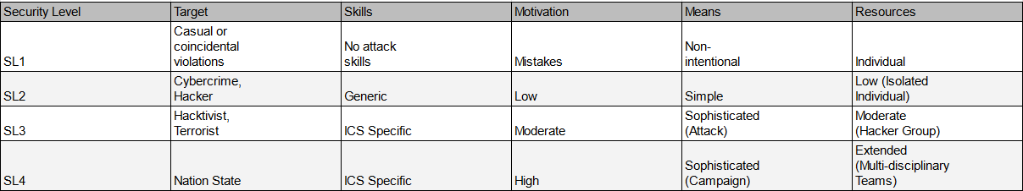
Security Levels
Security Implementation
From ISA/IEC 62443 Standard
Notes:
For our network we defined security levels in all of our zones, here is a chart that describes what all the security levels mean.

Slide 41
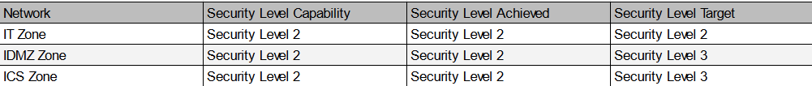
Security Levels in V2
Security Implementation
Notes:
SCOTT

Slide 42
Foundational requirements used in V2
Security Implementations
FR 1 – Identification and Authentication Control (IAC)
SR 1.1 – Human User Identification and Authentication
SR 1.3 – Account management
SR 1.11 – Unsuccessful login attempts
FR 2 – Use Control (UC)
SR 2.1 – Authorization enforcement
SR 2.5 – Session Lock
Notes:
SCOTT

Slide 43
Foundational requirements used in V2
Security Implementations
FR 3 – System Integrity (SI)
SR 3.2 – Malicious code protection
SR 3.4 – Software and information integrity
FR 5 – Restricted Data Flow (RDF)
SR 5.1 – Network segmentation
SR 5.2 – Zone boundary protection
FR 6 – Timely Response to Events (TRE)
SR 6.1 – Audit log accessibility
SR 6.2 – Continuous monitoring
Notes:
SCOTT

Slide 44

Conclusion
Design and build virtual test network with vulnerabilities
Perform vulnerability analysis and assessment
Simulate ransomware attack
Improve virtual test network with security implementations
Notes:
Ransomwares effect on industrial organization?

Slide 45
QUESTIONS
Notes:
Maybe add picture

Slide 46
Thanks for listening!

Slide 47
Sources
“Ransomware attack leads to shutdown of major U.S. pipeline system,” The Washington Post, 08-May-2021. [Online]. Available: https://www.washingtonpost.com/business/2021/05/08/cyber-attack-colonial-pipeline/. [Accessed: 01-May-2023].
“Utility companies among those impacted by ransomware attack.” [Online]. Available: https://www.tdworld.com/smart-utility/grid-security/article/20969707/utility-companies-among-those-impacted-by-ransomware-attack. [Accessed: 02-May-2023].
“Why was the WannaCry attack such a big deal?,” YouTube, 26-May-2017. [Online]. Available: https://www.youtube.com/watch?v=etPizFNPupk. [Accessed: 01-May-2023].
“Trojan.ransom.wannacrypt (WANACRYPT0R 2.0/WannaCry, NHS ransomware),” YouTube, 14-May-2017. [Online]. Available: https://www.youtube.com/watch?v=Zy4G30kSPnY. [Accessed: 01-May-2023].
“Wannacry Demo (propagation and killswitch),” YouTube, 25-Dec-2017. [Online]. Available: https://www.youtube.com/watch?v=Bc8o5jrL2_g. [Accessed: 01-May-2023].
“How wannacry ransomware works,” YouTube, 15-May-2017. [Online]. Available: https://www.youtube.com/watch?v=agFgibQydzg&t=56s. [Accessed: 01-May-2023].

